Slide 1
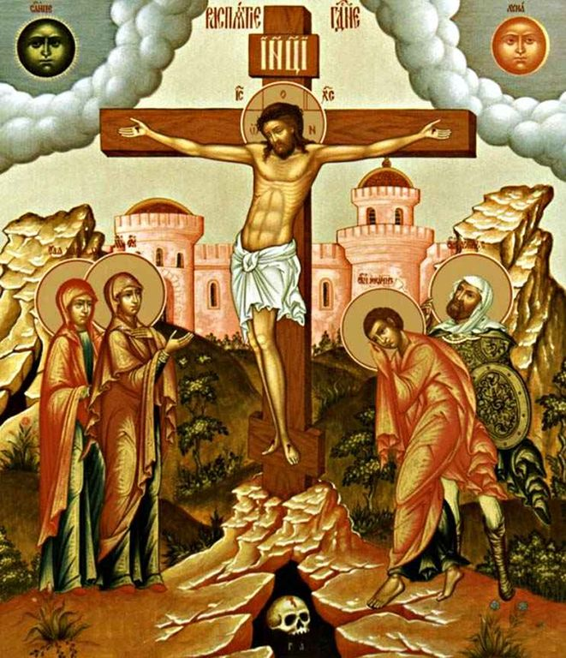
CATECHISM TRUTHS
OF CHRISTIANITY
Father Vladimir NESTERENKO

Slide 2
TWO MAIN COMMANDMENTS OF LOVE
Thou shalt love the LORD thy God with all thy heart, and with all thy soul; with all thy strength, and with all thy mind. This is the first and greatest commandment.
And the second is similar to it: love your neighbor as yourself
(Matt. 22: 37-39).

Slide 3
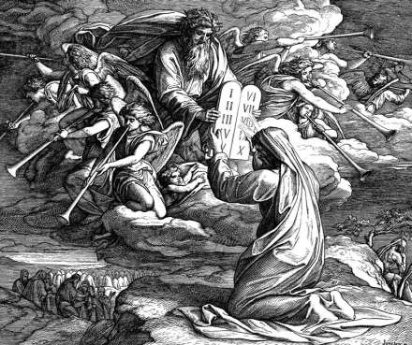
THE TEN COMMANDMENTS OF GOD
I am the Lord your God.
Let there will be no other gods in you but me.

Slide 4
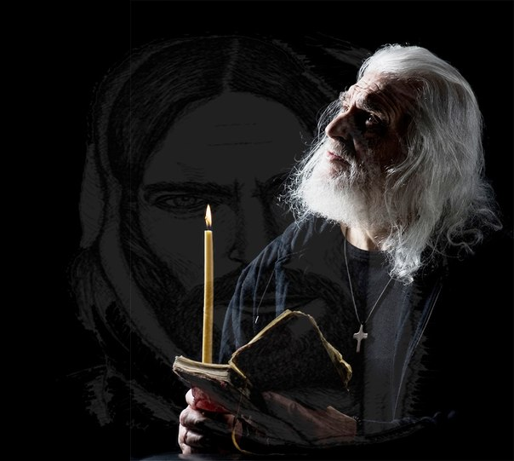
THE TEN COMMANDMENTS OF GOD
2. Thou shalt not take the name of the LORD thy God in vain.

Slide 5
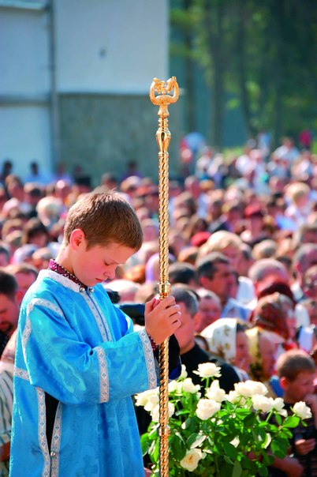
THE TEN COMMANDMENTS OF GOD
3. Remember to celebrate the holy day.

Slide 6
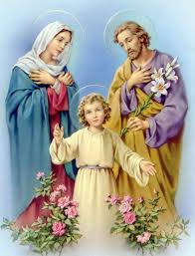
THE TEN COMMANDMENTS OF GOD
4. Honor thy father and thy mother.

Slide 7
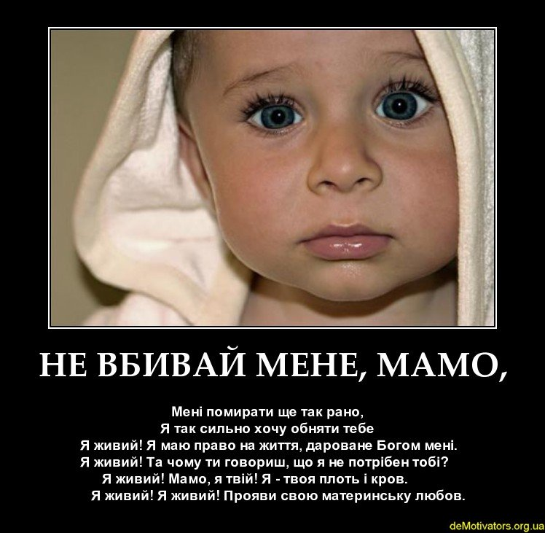
THE TEN COMMANDMENTS OF GOD
5. Don't kill.

Slide 8
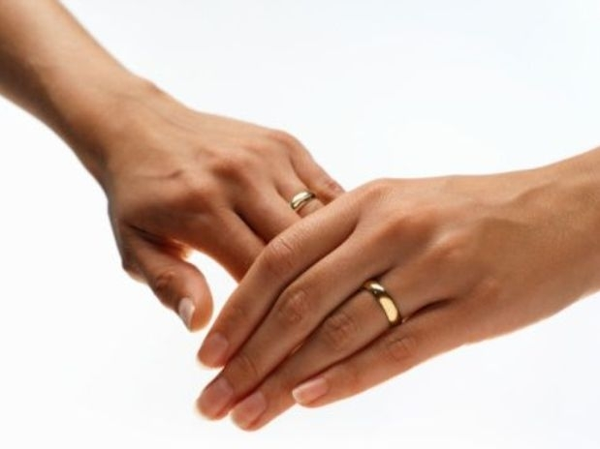
THE TEN COMMANDMENTS OF GOD
6. Do not commit adultery.

Slide 9
THE TEN COMMANDMENTS OF GOD
7. Don't steal.

Slide 10
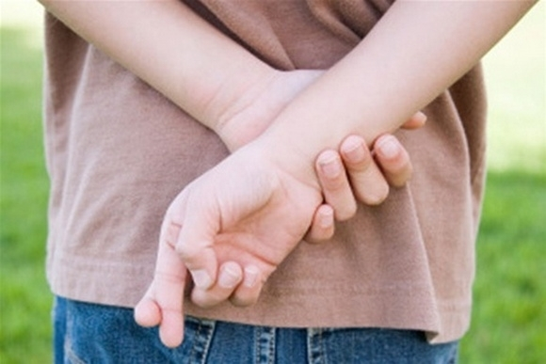
THE TEN COMMANDMENTS OF GOD
8. Thou shalt not bear false witness against thy neighbor.

Slide 11
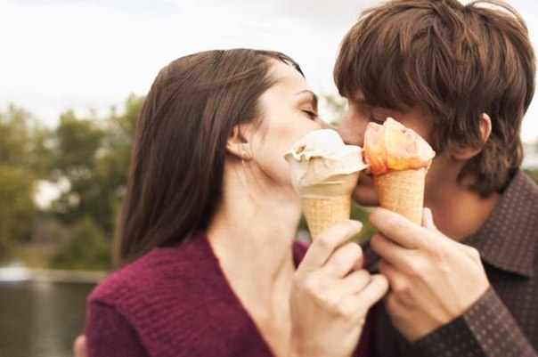
THE TEN COMMANDMENTS OF GOD
9. Thou shalt not covet thy neighbor's wife.

Slide 12
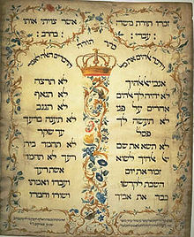
THE TEN COMMANDMENTS OF GOD
10. Do not covet anything that is the property of your neighbor.

Slide 13
SIX CHURCH COMMANDMENTS
Celebrate established holidays.
2. On Sundays and holidays to take part in the Holy Liturgy.
3. Established posts to fast.
4. Every year, at least once, at Easter time, confess and take communion.
5. In forbidden times do not celebrate weddings and parties.
6. Do not read evil books and letters.

Slide 14
THE SEVEN HOLY MYSTERIES
1. Baptism
2. Anointing
3. The Holy Eucharist
4. Repentance-confession
5. Anointing
6. Martimony
7. Priesthood

Slide 15
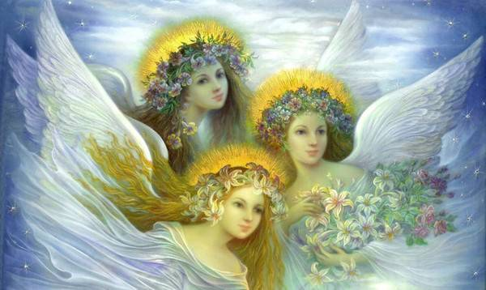
GOD'S VIRTUES
Faith
2. Hope
3. Love

Slide 16
MORAL VIRTUES
Prudence (haste)
2. Justice
3. Courage
4. Restraint

Slide 17
MAIN GOOD DEEDS
Prayer
2. Fasting
3. Alms

Slide 18
THREE GOSPEL COUNCILS
Voluntary poverty
2. Lifetime purity
3. Perfect obedience

Slide 19
SEVEN DEEDS OF MERCY FOR THE BODY
Feed the hungry
2. Give drink to Thirsty
3. Dress naked
4. Take the traveler home
5. To serve the sick
6. Visit the prisoner
7. Bury the deceased

Slide 20
SEVEN DEEDS OF MERCY FOR THE SOUL
In doubt to advise
2. Teach the ignorant
3. To convert the sinner
4. Sad to amuse
5. To forgive the insult from the heart
6. Patiently bear the guilt
7. Pray for the living and the dead

Slide 21
SEVEN GIFTS OF THE HOLY SPIRIT
Wisdom
2. The mind
3. Council
4. Strenghth
5. Knowledge
6. Piety
7. The fear of God

Slide 22
NINE FRUITS OF THE HOLY SPIRIT
1. Love
2. Joy
3. Peace
4. Patience
5. Quality
6. Mercy
7. Faith
8. Gentleness
9. Moderation

Slide 23
GOSPEL BLESSINGS
Blessed are you poor in spirit for theirs is the kingdom of heaven.
2. Blessed quiet for they shall inherit the earth.
3. Blessed upset for they shall be comforted.
4. Blessed hungry and thirsty for justice for they shall be filled.

Slide 24
GOSPEL BLESSINGS
5. Bliss merciful for they are merciful.
6. Blissful pure heart for they shall see God.
7. Bliss peacekeepers for they shall be called sons of God.

Slide 25
GOSPEL BLESSINGS
8. Blissful persecuted for the truth for theirs is the kingdom of heaven.
Blessed are you when you are despised, persecuted, and rebuked
all misfortune befalls you, for my sake. Rejoice and be glad, for your reward is great in heaven.

Slide 26
MAIN SINS AND
AGAINST THEM VIRTUES
1. Gluttony - moderation
2. Wantonness - chastity
3. Love of money - sacrifice
4. Sorrow - joy in the Holy Spirit
5. Anger - long-suffering
6. Boredom - cheerfulness of spirit
7. Vanity-humble wisdom
8. Pride - obedience

Slide 27
SINS AGAINST THE HOLY SPIRIT
Excessive hope in God's mercy
2. Hopelessness for God's mercy
3. Opposition to the known truth
of the Christian faith
4. Envy of others
God's grace
5. Fossilization to save the memory
6. Unrepentance until death

Slide 28
SOMEONE ELSE'S SINS
1. To command to commit a sin
2. Encourage sin
3. Advise to sin
4. Allow for sin
5. To help with sin
6. Do not punish for sin
7. It is a sin to defend
8. It is a sin to praise
9. It is a sin to be silent

Slide 29
CALLING SINS
ABOUT VENGEANCE TO HEAVEN
Intentional homicide
2. The sin of Sodom
3. Offending the poor, widows and orphans
4. Detention of wages

Slide 30
LAST THINGS
Death
Court
Heaven or hell

Slide 31
