Slide 1
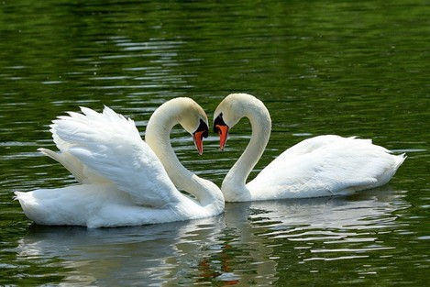
MARRIAGE ADVISOR
Father VOLODYMYR NESTERENKO

Slide 2
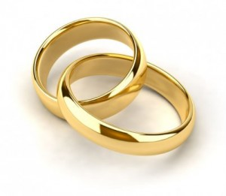
LOVE AND HAPPINESS
Love - the most relevant topic of radio, cinema and television.
Daily we hear and talk about love, however, have we thought really at least once what this concept means: "love”.
The same applies to and happiness. Everyone is talking about it, everyone is looking for it, but how many are able to comprehend it?

Slide 3
LOVE AND HAPPINESS
It would seem that love and happiness are inseparable, however in practice it is often different.
Let's try to understand: why two people in love are not always happy.
As a rule, main reason this is that they have no understanding of what is true love, and they have a misconception of what is true happiness.

Slide 4
MUTUAL LOVE
Under mutual love is understood a union in which one person complements another.
The union to which the couple are called does not arise by itself, it is a process in which a man and a woman must work, taking into account all areas of their existence.

Slide 5
MUTUAL LOVE
Here some aspects in which the spouses must seek union, although in life these aspects are combined and affect each other some:
1. PHYSICAL CONNECTION -
It expresses and improves love. It is a kind of engine in the connection of souls.
It is fundamentally different from the union of animals, which is subject only to instinct.

Slide 6
MUTUAL LOVE
2. CONNECTION OF CHARACTERS-
Characters of each of the spouses are different. Some differences in temperament are related to the psychological characteristics of men and women, heredity, temperament, upbringing, biography.
The main thing in marriage is to achieve unanimity, regardless of character. The key to this should be the integration of different traits, complementarity, not absorption.

Slide 7
MUTUAL LOVE
3. CONNECTION IN ACTIVITY -
Sometimes doing the same job can be a connecting factor (eg a medical couple).
Different work can also enrich and complement the worldview of the couple (subject to dialogue and spiritual cooperation).
Harmonization of daily activities are a sign of union.

Slide 8
MUTUAL LOVE
4. UNITY OF TASTES AND HABITS-
These include: participating in entertainment together, being with friends, going to the theater, exhibitions, playing sports or tourism, reading and commenting on books.
Cinema, television, radio, shared hobbies can also be a factor for reunion. However, all this is only a good precondition for creating dialogue and love.

Slide 9
MUTUAL LOVE
5. ECONOMIC CONNECTION -
The economy is a common issue of the spouses and does not apply to only one of the members.
It would be good for economic family issues to be addressed together.

Slide 10
MUTUAL LOVE
6. CONNECTION OF HEARTS -
It means breaking down barriers, freeing oneself from resentment with love and for love; have common joys and experiences: the birth of a child, professional success or failure, etc.

Slide 11
MUTUAL LOVE
7. Unity of souls -
IN the spiritual life and in relation to God there is a very personal intimate zone; there is the spirituality of a married couple, common prayer, meditation, communication on the topics of spiritual experiences.
Moral issue of a married couple (eg the number of children) should be addressed jointly.
Union of souls in God - this is what allows love to be realized in full.

Slide 12
HAPPINESS
1. WHERE THERE IS NO TRUE HAPPINESS -
Human’s heart is constantly looking for happiness. The powerful means of social communication and the general opinion they form, contribute to people start seeing happiness in material things, in comfort, benefits and wealth.

Slide 13
HAPPINESS
They believe that happiness comes from outside and that in it we will find rest.
They do not think at the same time that when achieving the desired, a person always has new needs, illusions and dreams (the more we have, the more we want).

Slide 14
HAPPINESS
We have example of many people surrounded by comfort, fame, money, but joyless and frustrated.
It is because materiality, although it helps to achieve happiness and complements it, it is by no means happiness and cannot be identified with it.

Slide 15
HAPPINESS
2. TRUE HAPPINESS -
True happiness does not depend on external things, it is internal and simple.
Happiness - is a feeling of fullness and peace, which is constantly in the depths of the soul despite the difficulties and suffering.
In marriage happiness is achieved when love is what it should be when it fulfills the purposes for which God created this marriage: mutual love of man and woman, transfer of life physical and spiritual.

Slide 16
HAPPINESS
3. MARRIAGE OF LOVE AND HAPPINESS -
Happiness in marriage depends on whether we know how to live our love.
But love is not something static. It is fire in the fire which needs to be constantly supported.
Love only lasts a lifetime if the spouses are constantly practically implementing the task of love.

Slide 17
HAPPINESS
WHAT ARE THE TASKS OF LOVE?

Slide 18
HAPPINESS
1) To love - is to know:
It applies not only externally but also internally: learn about each other's positive and negative traits, common and different interests.
All it takes time and patience, because the mystery of the soul is boundless and must be solved consistently.
We also need to learn to express ourselves as we are, become transparent to others.

Slide 19
HAPPINESS
2) Love - means accepting yourself:
Above all we must accept ourselves as we are, not idealize ourselves or others.
Also accept the work of your partner with all its difficulties and problems (urgent departure, difficult schedule, etc.).

Slide 20
HAPPINESS
3) Accept ourselves as we can be (become):
Life is full of changes: loss money and work, illness - all such difficulties in life help deepen love, make it mature.
We never should not be tempted by the thought that during changes in life, especially if they are negative or not very pleasant, we should leave everything and run away: to leave work, friends, leave the woman and children and to go to entertainments, to look for adventure out of wedlock.

Slide 21
HAPPINESS
We have to learn to accept life in its changes, in the timeline, we must prepare ourselves to accept ourselves and others with the changes that life can cause us.

Slide 22
HAPPINESS
4) To love is to understand and be able to forgive:
Need to be able to overcome selfishness - self-love - true love, to practice tolerance and devotion.
Refusal from oneself in order to give oneself to others is the main thing in marriage.
We need to remember the following: in disputes we can't go to sleep until we have not yet reconciled.

Slide 23
HAPPINESS
5) To love is to be patient and be able to wait:
Not one might think that everything is given to us ready. Character adaptation, sexual adaptation require great patience from both spouses.
The Skill to wait and not take hasty steps, don't make decisions hot – is a guarantee of the duration of love.

