Slide 1
Family as a Home Church
Sacrament of Married couple:
personal, spiritual and social aspects
Volodymyr Nesterenko

Slide 2
Family as a Home Church
The idea of ​​the home Church originates in the Holy Scriptures and develops later in the Holy Father's literature.
New Testament the source for this is Jesus' assurance of his presence: "For where two or three are gathered together in my name, there am I in the midst of them." (Matt. 18:20), and where Christ is present, there is His Church as the Body of Christ.

Slide 3
Family as a Home Church
In the book of Genesis of the Old Testament, we find two complementary biblical accounts of God's creation of the world, which provide a fundamental understanding of the meaning, purpose, and vocation of human life.

Slide 4
Family as a Home Church
In the first story, on the sixth day, God crowns his creation - he creates a being in his own image, he creates man as a man and a woman, as unity in diversity, as a community he wants to perfect through deification, to deify to be like the community of God's persons: Father, Son and Holy Spirit.

Slide 5
Family as a Home Church
God blesses the first couple: "Be fruitful" (Gen. 1:28) - indicates the task of creating a family, a large community - "Multiply and fill the earth" - as a continuation of the God-created process of creation in cooperation with God.

Slide 6
Family as a Home Church
God places the responsibility on man by giving authority: "Subordinate it to yourself [land]; rule over the fish of the sea, over the birds of the air ... ”, which requires from the spouses special cooperation with God and among themselves: to be a foundation and support, consolation and comfort for each other in the completion of God's plan - the likeness of man and all mankind to God.

Slide 7
Family as a Home Church
The second biblical story gives a more detailed description of the process of human creation. God creates man, Adam, "From earth dust" (Gen. 2: 7), which means the bodily (material) dimension of man, and "Breathed into his nostrils the breath of life, and the man became a living being" (Gen. 2: 7), that is, the image of God was implanted in man: the mind, free will - the immortal soul and spirit.

Slide 8
The family is the home Church
"It's not good for a man to be himself" (Gen. 2:18) - God creates for Adam a community of communication and love, creates a woman, Eve, in whom Adam saw a person equal to himself, similar and worthy of himself, who became his closest, given by God to help, to realize that special mission given by God.

Slide 9
Family as a Home Church
Man and woman are essentially the same (as the image of God), but at the same time from the very beginning are different in their sex, which is a prerequisite for intimacy between them - so close that both become "One body" (Gen. 2:24).

Slide 10
Family as a Home Church
The inability of the first spouse to carry out God's plan through the transgression of God's commandment, violated the harmony of human communication with God, with the world, as well as the original communion (communion) of man and woman.
Their harmonious relations have turned into mutual accusations; the mutual attraction of love for one another is replaced by a relationship of domination and lust, and the high vocation to fertility is burdened by the pain of childbirth and the hard work of obtaining bread.

Slide 11
Family as a Home Church
After the fall, the marital status of a man and a woman gains even more importance in overcoming self-isolation, overcoming selfishness, egoism, lust, and self-satisfaction; marital status helps to open up to another person for mutual help and self-giving; helps, in a special way, through human love to approach the love of God in which God himself reveals himself, himself descends to man.

Slide 12
Family as a Home Church
Christ, as the Son of God, himself came to fallen humanity to renew and transform all creation, to sow the seeds of the Kingdom of God here on earth, establishing his Church.

Slide 13
Family as a Home Church
Jesus Christ also transforms marriage and the family (the wedding in Cana of Galilee), gives them the strength and grace to live in the new dimensions of the Kingdom of God, as a community of saints, a community of love - as His disciples proclaiming the Gospel and building and multiplying His Church. .

Slide 14
Family as a Home Church
This, in fact, distinguishes the New Testament doctrine of marriage from the Old Testament: the sanctity of life as the Church of Christ.

Slide 15
Family as a Home Church
And this means the depth of mutual love and self-sacrifice derived from the person of Christ, when a man and a woman together, following Jesus, denying themselves and taking up their cross, understand and realize God's eternal plan for their marriage, create and multiply the Church and in Christ and through Christ they take part in the life of God, the life of the Holy Trinity.

Slide 16
Family as a Home Church
The period of the early Church is characterized by the fact that meetings of Christians took place in the homes of Christian families.
For example, missionary the activities of the apostle Paul were in fact based on the founding of new churches in the homes of converted Christians and from there spread further, playing a leading role in the preaching of the gospel.

Slide 17
Family as a Home Church
In the letters of the Apostle Paul that we first encounter the term "Home church" (Latin: “ecclesia domestic” or Greek: : kat' oikon ekklesia), which at that time meant the gathering of Christians in the home of a Christian family rather than the family itself: "Greet Priscilla and Aquila, ... greet also their home Church" (Rom. 16: 3-5 and 23.1 and cf. Col. 16: 15-20, Cl. 4: 15,2 Tm. 4:19, Phil. 1-2).

Slide 18
Family as a Home Church
The Apostle Paul develops Christian theology a marriage restored and changed by Christ.
Paul represents it as Sacrament and equates to the mysterious connection of Christ and His Church, which on the other hand can be interpreted as the connection of Christ with matrimonial couple, as his small Church.

Slide 19
Family as a Home Church
In this way we can speak of the commonality of basic relations: the relations of love on which both the family and the church are built, and hence: the church as a large family and the family as a small church.
Apostle Paul presents the model of the marital relationship of husband and wife as Christ's self-sacrificing love for the Church and the Church's unconditional obedience to Christ.

Slide 20
Family as a Home Church
Since the beginnings of Christianity, the basis of the Church were those that "With the whole house" (Acts 8: 8) believed, and soon became the hearths of Christian life and love, and so today, in what is now often called "post-Christian" in Europe - practicing Christian families are like "first homes" who accepted Christ.
Exactly the Christian family becomes "The field into which the gospel is carried and from which it spreads."

Slide 21
UGCC Catechism about the family
In the Epistle to Ephesians the apostle Paul teaches about the sacrament communication Christ and Churches as a prototype of a marital relationship: "It's great mystery, and I speak of Christ and Church» (Eph. 5, 32). Marital life is a "mysterious icon of Church »,it’s a place of presence and action of Christ, a sign of new life.
Holy John Chrysostom calls married couple "Small church», which “day and night is present in front of the God’s face.

Slide 22
UGCC Catechism about the family
The Lord God blesses conjugal love and endows it with sacrifice and fertility. It unites two - a man and a woman - into one whole,which man cannot separate: «What, therefore, God united, man should not part " (Matt. 19: 6).

Slide 23
UGCC Catechism about the family
Marital unity is carried out in mutual gifts up to self-sacrifice: "Men, love your wives, how Christ loved The church and married to it. " (Eph. 5, 25).
Holy Spirit creates community of spouses “Home church».
IN prayers of Wedding rank the priest asks God: “Lord our God, crown them with glory and honor».

Slide 24
UGCC Catechism about the family
An essential feature of a Christian marriage is fidelity that is based on faithful love of Christ, and not only on the human efforts of spouses.
Marital fidelity stems from God's fidelity to His promise and fidelity of Christ to His own Church.

Slide 25
UGCC Catechism about the family
Loyalty is cemented by participation in the Saint sacraments (Confessions and Communions), common prayer, mutual understanding, support, trust and forgiveness, as well as constant spiritual struggle against temptation.

Slide 26
UGCC Catechism about the family
Church, being faithful to the words of Jesus Christ, emphasizes continuity of the married couple: "Whosoever shall put away his wife, and marry another, is committing adultery with her. And when a woman leaves her husband and marries another, - is committing adultery » (Mark 10: 11-12).

Slide 27
UGCC Catechism about the family
In a marriage, a man and a woman are called to co-create with the Lord in birth of children: “Be fruitful and multiply and fill the earth and subdue it yourself » (Gen. 1:28).
Married couple is an icon of the Church of Christ, which gives birth to people for eternal life.

Slide 28
UGCC Catechism about the family
Speaking of the indissolubility of the spouses, it must be clearly stated that in the Catholic church have not been, are not and will not be divorces.
Unity and the indissolubility of the marriage is the essence of the teaching of Christ and the Church about marriage.

Slide 29
UGCC Catechism about the family
Christ himself spoke of indissolubility of marriage:
The Pharisees came and tempted him, and said, Is it lawful for a man to put away his wife? And he answered and said unto them, What did Moses command you? They said, "Moses allowed me to write a letter of separation and let her go."

Slide 30
UGCC Catechism about the family
“It is because of your hardened heart, Jesus said to them, that he wrote you this decree. And at the beginning of creation God created them man and woman. That is why a man will leave his father - mother and cling to his wife, and both will be one body; therefore no longer two, only one body.What, therefore, God will unite, let man not separate. ” (Mk 10: 2-9)

Slide 31
UGCC Catechism about the family
Similar norms are found in other texts of the New Testament. St. Paul gives an unequivocal statement:It is not I who command the married, but the Lord: A woman shall not separate from her husband; but if she divorce, let her remain unmarried, or be reconciled to her husband, and let not the husband let the woman go.(1 Cor 7: 10-11).

Slide 32
UGCC Catechism about the family
All The statements of the New Testament (Mark 10: 2n; Luke 16:18; 1 Corinthians 7:10) are so clear that we come to a statement that excludes the possibility of remarriage during the life of a man (woman), albeit divorced.

Slide 33
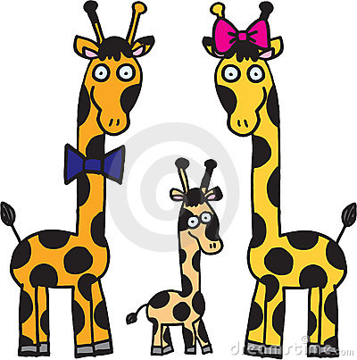
The goals of the couple:
MARRIAGE OF LOVE
CHILDBIRTH

Slide 34
MARRIAGE OF LOVE
Marital love -
this is a great natural human need.
It cannot be replaced by the strongest or the best
friendship. There is no such thing in any other connection
complete devotion nor the exclusivities that are inherent
for conjugal love.

Slide 35
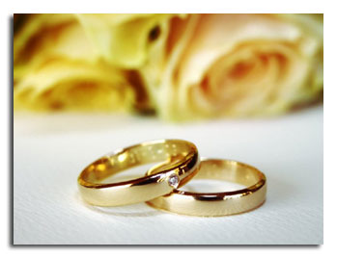
The family is the home Church
In order to build a mature conjugal love,
should be mature man, you need to know yourself and
to know the other person we love must also know
the rights that govern masculinity and femininity.
Only after a good knowledge of yourself
and the second person can be conscious
and with the conviction to say “I am getting married
faithfulness and love to you until death ”

Slide 36
Persons preparing for marriage,
must form an ability
understanding and experiencing self-aspirations,
feelings and needs of the other party.
Only then marriage can be
happy and constant. Understanding the other,
co-feeling - requires of us
emotional and spiritual maturity.

Slide 37
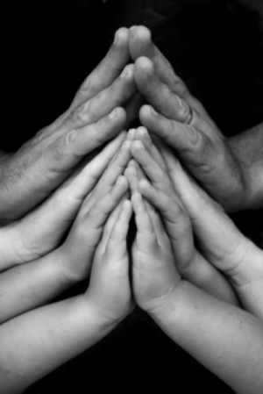
A measure of authentic love between
Engaged people are not only
emotional affection but ability
to "die" for their aspirations,
to live longer for another
A true stay in God is guaranteed
also true being in love.
God himself is the source of authentic love.

Slide 38
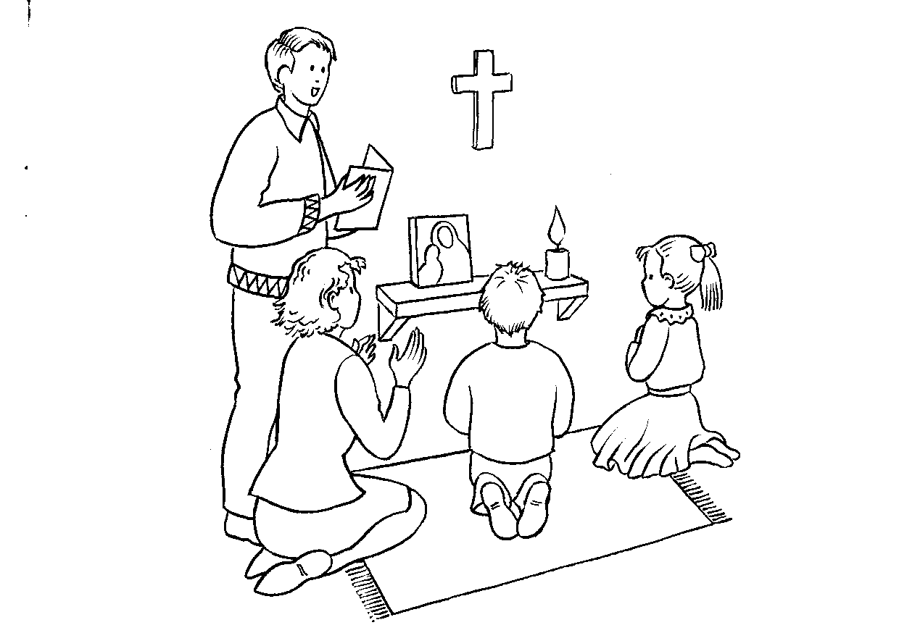
God, who is the source and guarantor of human love,
calls spouses to come to Him together.
According to God's intention, marriage
is way to God.
Going to God and to
the fulfillment of His will takes place
in a marital relationship thanks to
mutual devotion.

Slide 39
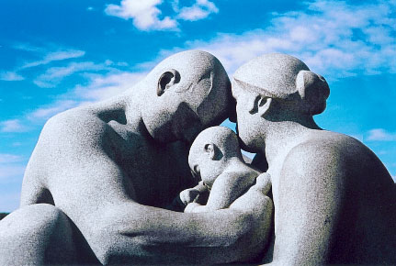
The wife must seek God not only together with
her husband, but also in her husband, and vice versa.
The truer their love, the fuller and deeper it leads them to the love of God, whom they discover in themselves.

Slide 40
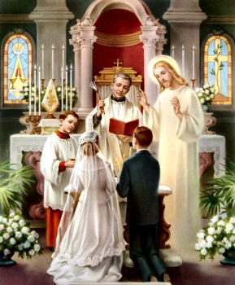
MARRIAGE AS SACRAMENT
“Marriage, thanks to which
man and woman create a unit
for life, aimed at their own
natural character for good of the
spouses and for childbirth and
parenting: this union between
baptized was raised by
Christ the Lord to the dignity of the sacrament ”
(Code of Canon Law, 1055, 1).

Slide 41
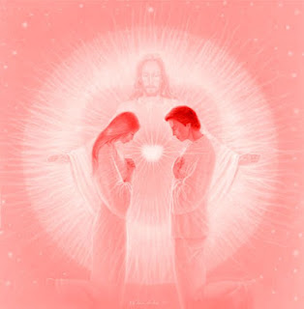
Through the sacrament of marriage, God expresses his own
desire, that spouses united by
common love,
went to Him together.

Slide 42
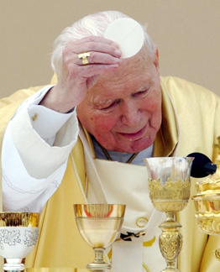
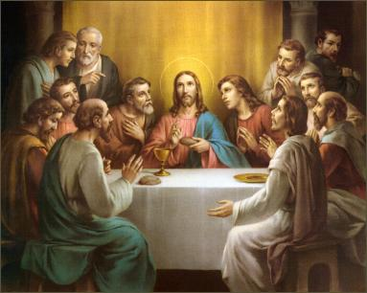
The husband is given to the wife as friend
and a helper on the way to God, as well
and woman is given to husband. This is a common path to God should be
expressed in concrete signs.
One such sign can
be a common prayer,
full participation in the Eucharist.

Slide 43
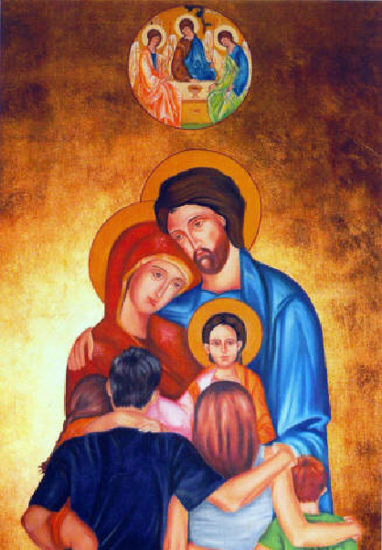
If it is natural for spouses to experience certain events together, rejoice together, grieve, suffer together, then why can't they also pray together?
Praying together can unite them more than anything else; can also clean them to allow for forgiveness.

Slide 44
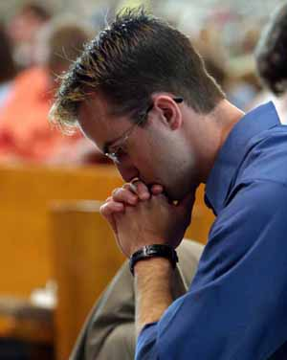
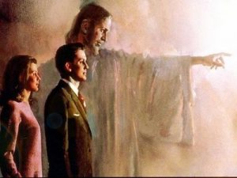
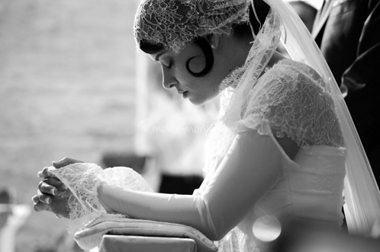
Misunderstandings, conflicts, inconsistencies of opinion - it is the "daily bread" of the most successful couples.
Prayer is then an invitation to unity, forgiveness and
consent

Slide 45
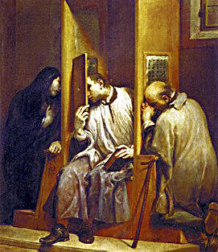
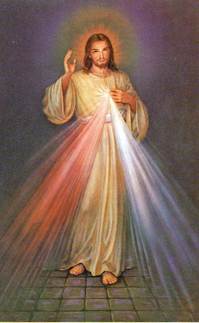
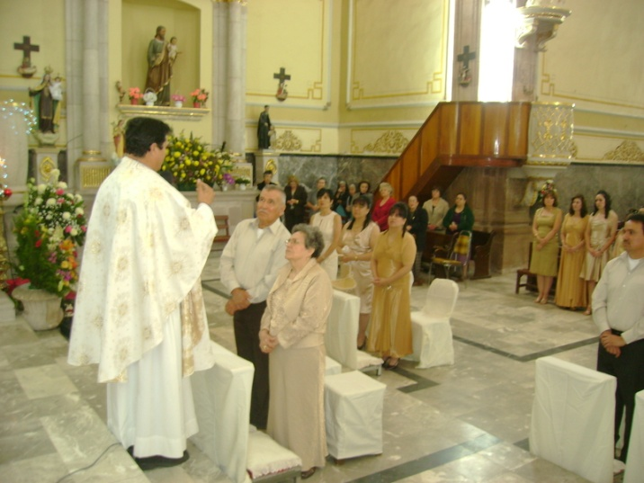
PARTICIPATION MARRIED COUPLE IN THE MYSTERIES Of the Eucharist AND CONFESSION

Slide 46
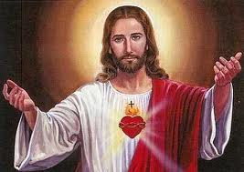
“To heal the wounds of sin,
man and woman need
help of grace in which God
in his infinite mercy
he never refused them.
Without this help, a man and a woman can not
achieve the unity of their lives,
for which God created them "in the beginning".
(CCC 1608)

Slide 47
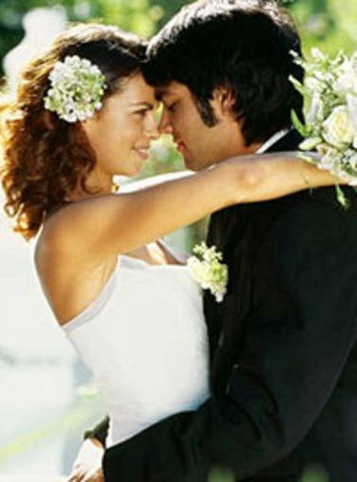
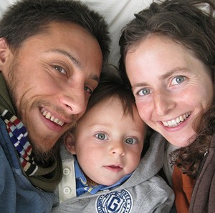
CHILDBIRTH
Marriage is a community of man and woman,
in which there is a complementarity,
giving oneself and accepting the gift of another.
Physical unity is important
component of the marital community. Thanks to
this addition spouses are involved in
God's work of creation through birth and
rearing offspring.

Slide 48
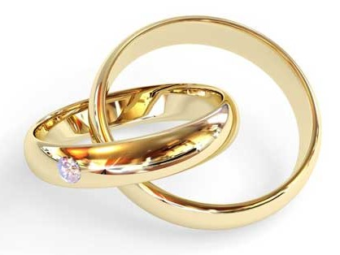
Marriage is established by God, not man, and therefore marriage has sacred character.
The souses have in front of the them two tasks,which are performed were sexuality plays an irreplaceable role:
Growth in love
Adoption (birth) of children

Slide 49
The transfer of life and inextricably linked
with this task raising of offspring can
be fully implemented
only in the atmosphere of
unity and continuity of
marital relationship.

Slide 50
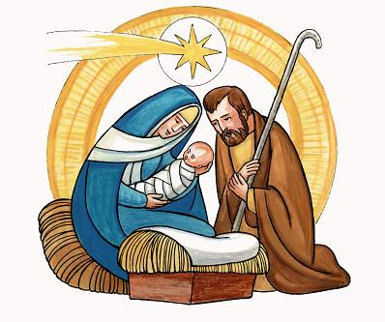
Marriage is the foundation of the family, that is, it is a union of love that gives birth to a community of individuals.
There is a Christian family is communio personarum, is a community of people for whom the inherent way of existence and life is "communion". Only individuals are able to live in "communion."

Slide 51
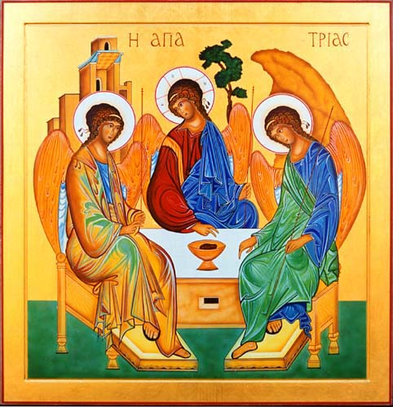
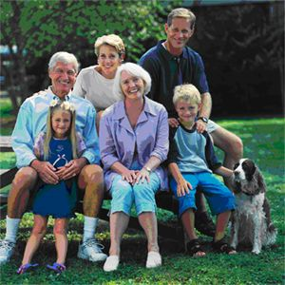
The family is the sign and image of the
community Of the Holy Trinity:
FATHER and SON in THE HOLY
SPIRIT.
It is also the main cell of public life. It is a community in which from childhood you can learn moral and religious values,
to live in safety, in love.

Slide 52
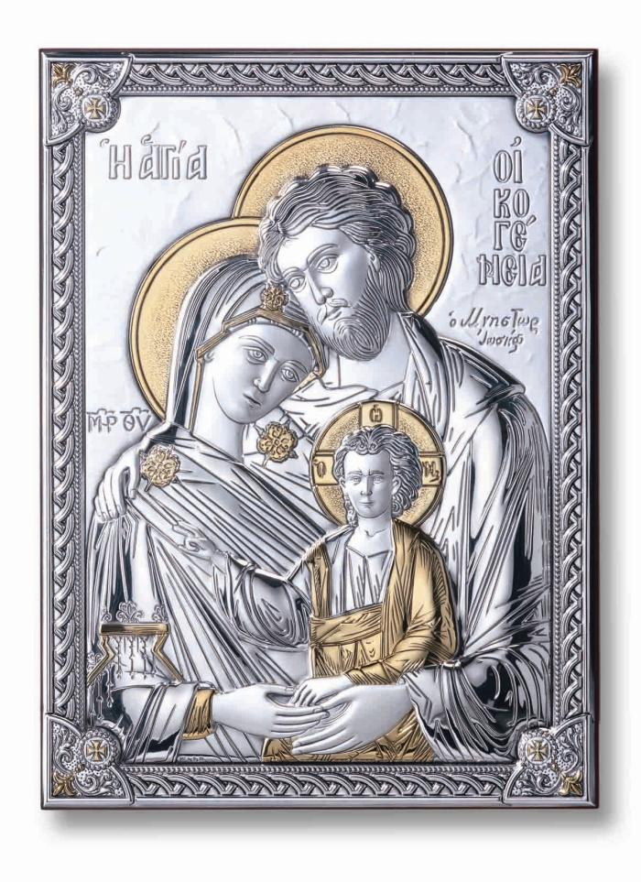
The family is a community of human beings,
united in love around mystery of
the gift of life, which is accepted in love.
In the light of creation, the family is the place of the presence of God, who reveals his creative power.
"Children are the most valuable gift of a couple"
(II Watt. Cathedral, "Joy and Hope", 50)

Slide 53
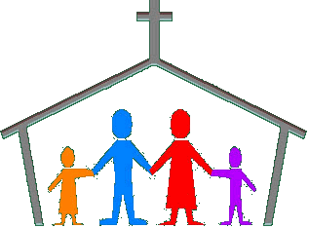
The family is the home Church
Physical fertility has a deep meaning
only when connected with the mental and spiritual
fertility.

Slide 54
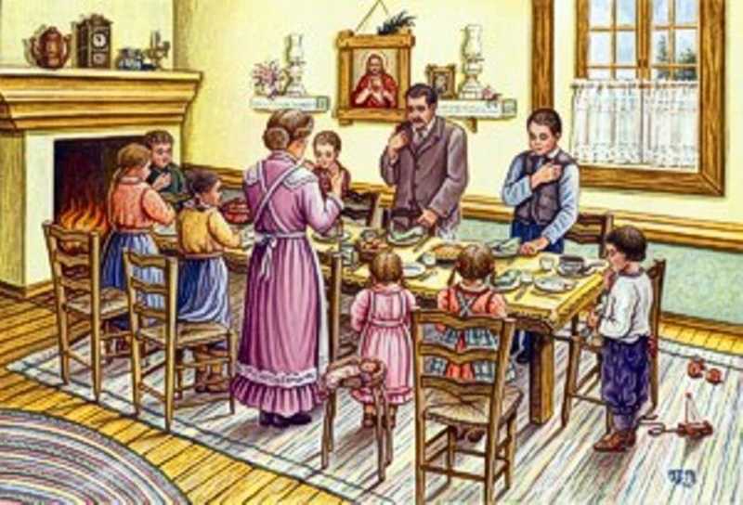
“The fruitfulness of conjugal love extends to
the fruits of moral, spiritual and supernatural life,
that their parents pass on to their children through upbringing.
Parents are the main and first educators of their own
children. In this sense
the main task
spouses and families are to be
in the service of life ”.
(KKK 1653)

Slide 55
The first and most important way of good
raising their children is the mutual love of parents and
responsible attitude to their parents
functions.
Thanks to mutual love
parents pass not only
human values, but also
teach deep trust in God.
Mutual love of parents is the first
The foundation of a child's love for God.

Slide 56
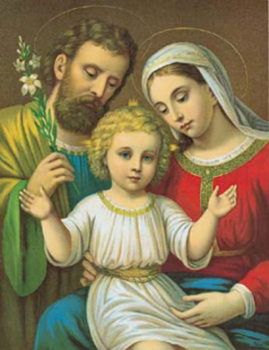
God Himself declaring His love
to man refers to human
relationship, maternal love,
although God's love is much greater.
Parents become an image for the child
Of the love of God. Thus realized
in their lives the words of the Book of Genesis:
God created man in his own image, in the image of God
created them.

