Slide 1
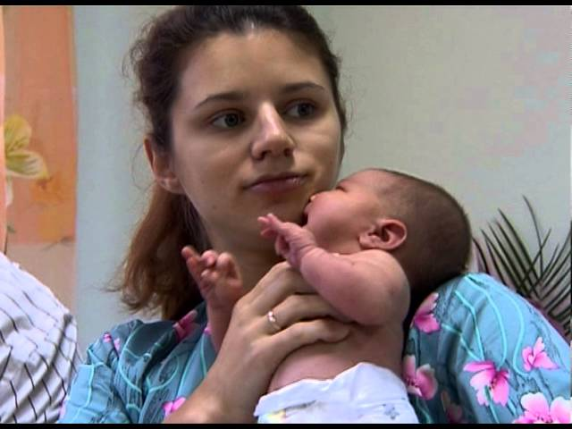
MORAL ASPECTS OF CHILDBIRTH
Father Volodymyr NESTERENKO

Slide 2
MORAL ASPECTS OF CHILDBIRTH
Marriage gives rise to a special responsibility of man and woman: responsibility for the common good of the family.
This common good is created by man, the value of the person and everything that determines the degree of his dignity.
Marital love requires a man and a woman to properly understand their duty of responsible parenthood.

Slide 3
PROPER UNDERSTANDING OF RESPONSIBLE PARENTING
Given the innate human urges and emotions, responsible parenting means that they must be mastered by the forces of reason and will.

Slide 4
PROPER UNDERSTANDING OF RESPONSIBLE PARENTING
Taking into account the physical, economic, psychological and social conditions, responsible parenting should be practiced both by those who wisely and generously decide to have more children, and those who, for good reasons, respect moral precepts, decide not to have subsequent children for a certain period. definite or indefinite time.

Slide 5
PROPER UNDERSTANDING OF RESPONSIBLE PARENTING
The task of responsible parenthood requires friends to acknowledge their responsibilities to God, to themselves, to their families, and to human society, while maintaining a proper order of goodness and values.

Slide 6
RESPONSIBILITY FOR POTENTIAL AND REAL FATHERHOOD AND MOTHERHOOD
The birth of a new life is at the same time the beginning of a new stage in the life of a husband and wife: they become parents.
A woman is called to be a mother, just as a man is called to be a father.
The moment they give birth to a new person, they realize that calling.

Slide 7
RESPONSIBILITY FOR POTENTIAL AND REAL FATHERHOOD AND MOTHERHOOD
What was potentially inscribed in their nature becomes reality.
They are responsible for their potential and then actual fatherhood and motherhood

Slide 8
RESPONSIBILITY FOR POTENTIAL AND REAL FATHERHOOD AND MOTHERHOOD
Human fatherhood and motherhood, despite their biological similarity to the fatherhood and motherhood of other living beings in nature, are meaningfully and uniquely similar to God, who forms the basis of the family as a community of human life, as a communion of persons united in love.

Slide 9
RESPONSIBILITY FOR POTENTIAL AND REAL FATHERHOOD AND MOTHERHOOD
Responsible parenting involves understanding what is sexual intercourse.
For believers, the act leading to the birth of a child becomes even more important because it involves the special intervention of God the Creator.

Slide 10
RESPONSIBILITY FOR POTENTIAL AND REAL FATHERHOOD AND MOTHERHOOD
Parents who want to do their job well and responsibly to pass on life cannot and do not have the right to act arbitrarily.
Morally acceptable ways of managing fertility do not depend only on their own arbitrary desire.

Slide 11
RESPONSIBILITY FOR POTENTIAL AND REAL FATHERHOOD AND MOTHERHOOD
They are obliged to orient their behavior to God's plan of creation, which, on the one hand, is expressed in the essence of marriage and its acts, and on the other - it is proclaimed by the constant teaching of the Church.

Slide 12
RESPONSIBILITY FOR POTENTIAL AND REAL FATHERHOOD AND MOTHERHOOD
Realization of responsible motherhood and fatherhood promotes fertility recognition methods (FRM), which are based on knowledge of human anatomy and physiology and at the same time respect human dignity and all aspects of human sexuality.

Slide 13
RESPONSIBILITY FOR POTENTIAL AND REAL FATHERHOOD AND MOTHERHOOD
FRMs are temporary restraint from sexual intercourse, if a married couple, having serious reasons for this (medical, economic and others), wants to postpone the birth of a child.
These methods exclude any interference in the proper functioning of the human body and do not violate the natural order of sexual intercourse.

Slide 14
RESPONSIBILITY FOR POTENTIAL AND REAL FATHERHOOD AND MOTHERHOOD
The advantage of FRM is that they help men and women to know and understand each other better, teach to dominate the sensory-emotional sphere, develop marital dialogue, give inner freedom and joy.

Slide 15
DENIAL OF RESPONSIBLE FATHERHOOD AND MOTHERHOOD
Because of human weakness, impurity and sin can creep into married life.
Especially this is evident in the attitude to childbearing, namely in the denial of this goal of the spouses (contraception and sterilization) or the destruction of a new life already conceived (abortion).

Slide 16
DENIAL OF RESPONSIBLE FATHERHOOD AND MOTHERHOOD
In case of infertility, some couples resort to artificial insemination, however, this method of having a child does not comply with the principles of responsibile paternity.

