Slide 1
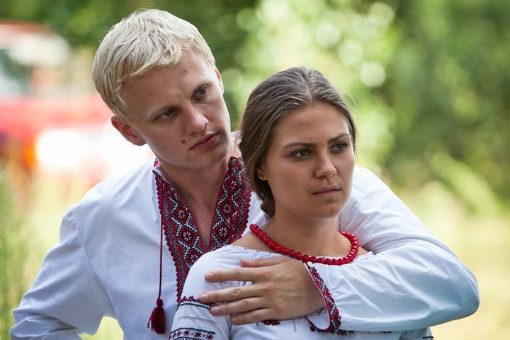
"Man and woman created them"
The gift and task of sexuality
Father Volodymyr NESTERENKO

Slide 2
Catechism of the UGCC about the gift of sexuality
Sexuality encompasses all the natural dimensions of the existence of the human person: it denotes not only the body, which is a visible sign of belonging to sex, but also the soul and spirit of man.

Slide 3
Sexuality is God's gift of being a man or a woman, which each person receives in his creation. Therefore, man is called to accept this gift of God and to embody it in his life.

Slide 4
God created man male and female, so sex is a gift of God
does not depend on the person's choice (Bt.17).
Sexual intercourse between a woman and a man in a God-blessed marriage is a manifestation of marital love
between a man and a woman.

Slide 5
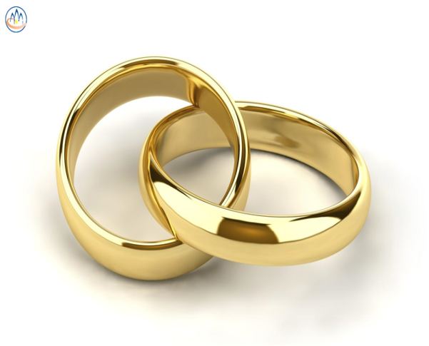
By sexual intercourse spouses unite in love, showing inseparable unity of married life.
True conjugal love is fruitful love, so the bodily union of spouses is open to childbearing.

Slide 6
Sexual intercourse has a double dimension: unifying (in love) and reproductive and excludes the use of contraceptives). Only such a marital act is chaste and pure.

Slide 7
Loss at least one of these dimensions of sexual intercourse distorts its meaning, destroys the chastity and purity of married life, and therefore is a sin.

Slide 8
Intercourse outside the sacrament of marriage, marital infidelity, the destruction of marital fertility by abortion and contraception are a humiliation of the human person and a grave sin.

Slide 9
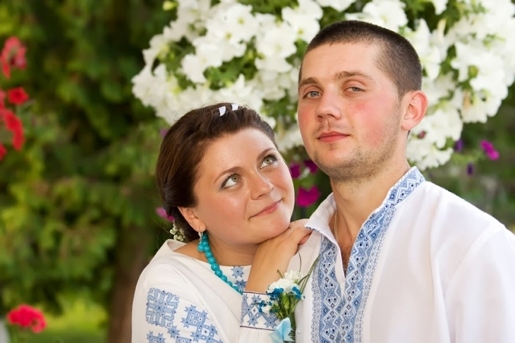
Any selfish use of another person as a means of sexual pleasure contradicts God's gift of love, distorts the essence of sexuality and deeply hurts the person..

Slide 10
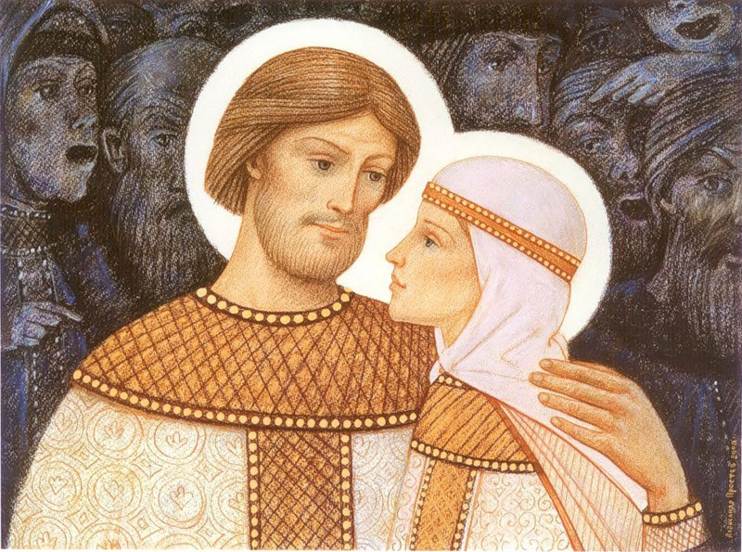
In marriage, a man and a woman must open themselves to God through mutual love, which becomes the basis of their inseparable unity, fidelity and fruitfulness.

Slide 11
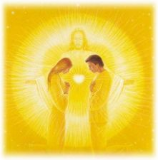
Sexuality encompasses all the natural dimensions of the existence of the human person: it denotes not only the body, which is a visible sign of gender, but also the soul and spirit of man.

Slide 12
Human sexuality can be understood only in the light of the Christian understanding of love as the communion of persons.
Such communion is carried out in love as the self-giving of one person to another. This love is given to a person by the Holy Spirit, who reveals it to another person.

Slide 13
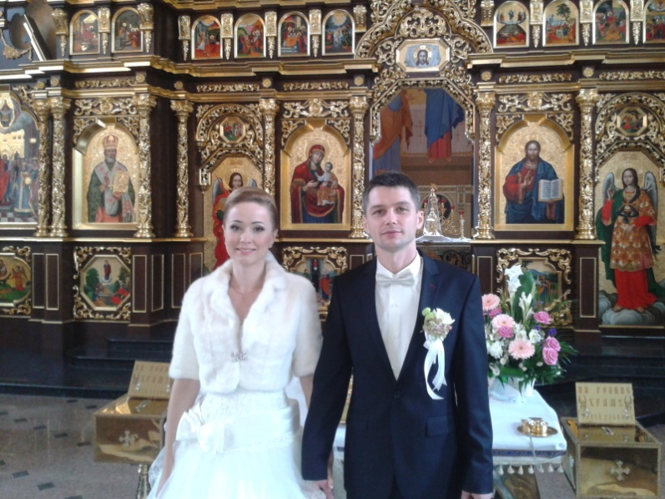
In married life, a man and a woman open themselves to God through mutual love, which becomes the basis of their inseparable unity, fidelity and fruitfulness..

Slide 14
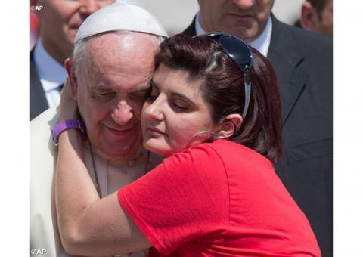
IN the virgin life consecrated to God, sexuality is transformed in the Holy Spirit in order to serve God and neighbor in love for the sake of the Kingdom of Heaven (see Mt 19:12).

Slide 15
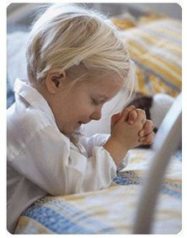
Everyone is called from an early age to love both God and neighbor. In the education of love is the content of Christian sex education.

Slide 16
The purpose of such education is to help a developing young person to discover God's gift of sexuality and to learn to respect the personal nature of this gift..

Slide 17
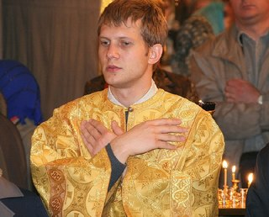
Sexuality in the deepest sense is not only a place of deep interpersonal experience, but also a place of encounter with God, helping to understand why the Church touches on the topic of sexuality and sexual relations in general.

Slide 18
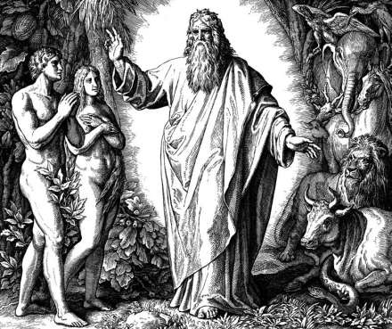
Sexuality as a gift from God
The Bible clearly tells us that God created the first humans by man and woman (Gen. 1:27).

Slide 19
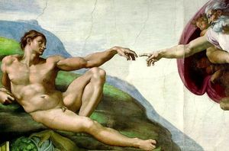
Sexuality as a gift from God
By realizing his own body, Adam could see that he was different from other creatures and could rejoice at the creation of Eve.
The human body, which is the gift of God the Creator, has from the beginning a marital sign.

Slide 20
Sexuality as a gift from God
Only God is Holy, and the created man together with his body is the object of holiness, that is, the embodied image of the holiness of God.
At the same time, it is the "mystery" of creation, and therefore the sign of God in the world.
The sanctification of the world takes place through the human body, just as the salvation of the world took place through the Incarnation of Jesus Christ, the perfect Image of God.

Slide 21
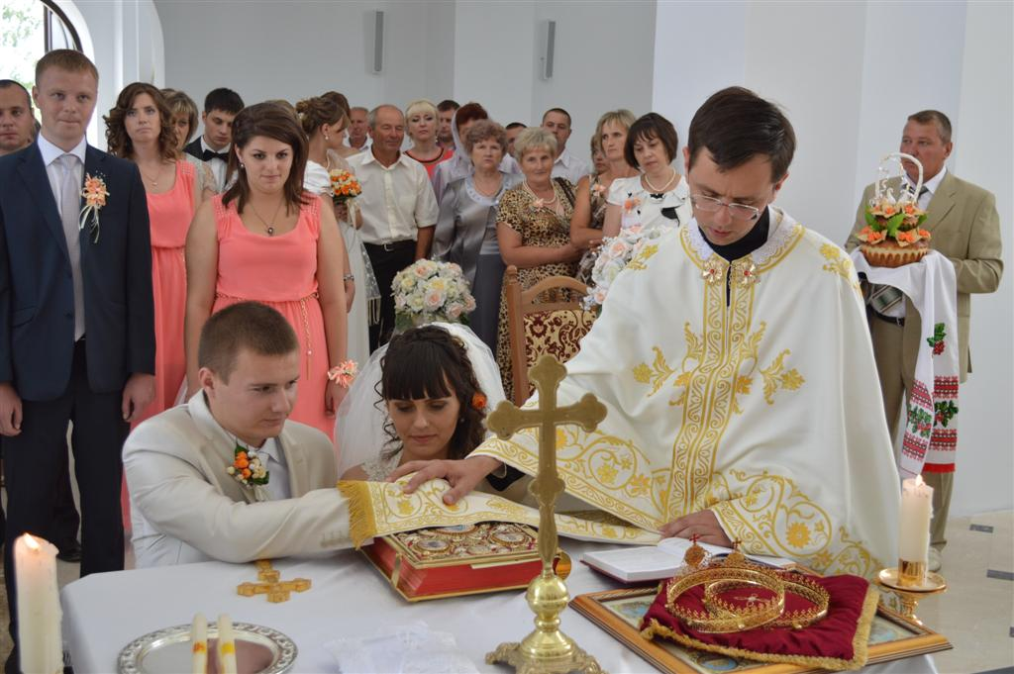
Sexuality as a gift from God
Human sexuality is also a part of God's plan, as an integral part of the capacity for love that God has invested in man and woman.

Slide 22
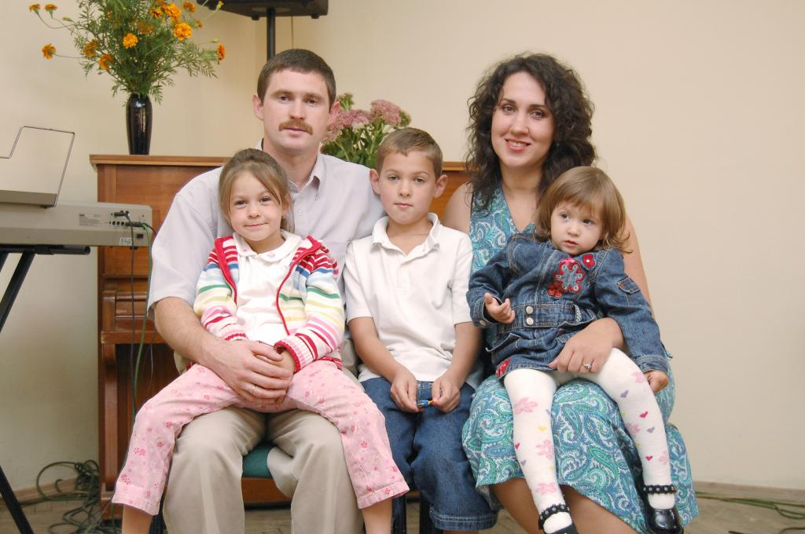
Sexuality as a gift from God
This ability to love as a gift of self is embodied in the conjugal meaning of the body, which bears the imprint of human femininity and masculinity.

Slide 23
Sexuality as a gift from God
The body is not only a source of fertility, but has the ability to express love, in which a person becomes a gift to another person.
The division into sexes was conceived by God, and He put deep meaning into the creation of man and woman.

Slide 24
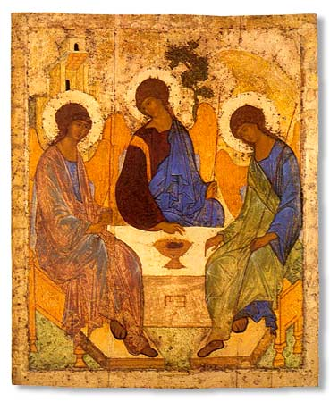
Sexuality as a gift from God
God is essentially a community of Three Persons, between whom there is a continual gift.

Slide 25
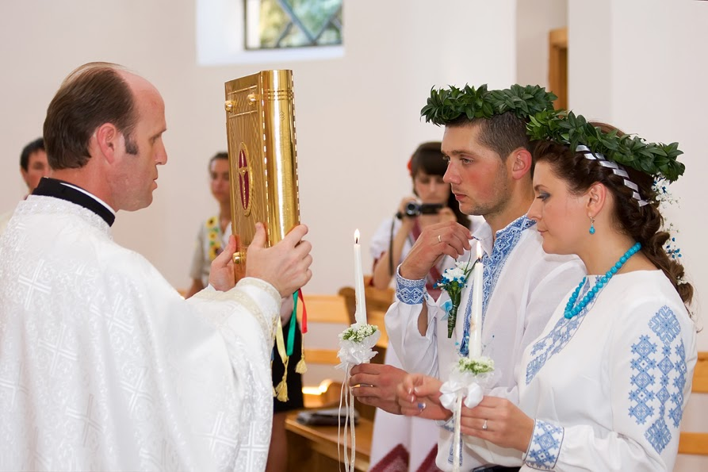
Sexuality as a gift from God
Human community must reflect the unity that exists in the Holy Trinity.
Man and woman, who create a community of love, are called to give life by cooperating with God.

Slide 26
Sexuality as a gift from God
The whole person is the image of God-Love, and all parts of his life must be subject to God's plan.
Part of of this image, through which God-Love becomes present in human life, there is also the human corporeality and the sexuality associated with it.

Slide 27
Sexuality as a gift from God
In God-Love we find the source for all the principles of Christian sexual ethics.

Slide 28
Sexuality as a gift from God
Man as the embodied spirit, that is, the soul expressed through the body, and the body formed through the immortal soul, called to love just as this unity.
Love embraces the human body, and the body also participates in spiritual love.

Slide 29
Sexuality as a gift from God
In a Christian marriage, love to person is at the same time love to Christ.
Hence the purity and selflessness of conjugal love.
Every true love wants to make a loved one happy. Therefore, there is a search of happiness for another, not your own pleasure.

Slide 30
Sexuality as a gift from God
The human person is realized on three main structural levels: biological, psychological and spiritual - so, trying to characterize it, you can not miss any of them.

Slide 31
Sexuality as a gift from God
Sexuality - is the energy that emanates from the whole person, from all levels of its internal structure.

Slide 32
Sexuality as a gift from God
“Everything is possible for me, but not everything is useful ... The body is not for fornication, but for the Lord, and the Lord for the body ... Do you not know that your bodies are members of Christ? Don't you know that your body is the temple of the Holy Spirit who dwells in you? You have it from God, so you no longer belong to yourself. You are bought at a high price! So glorify God in your body! ”
(1Cor 6, 12‑15a.19-20).

Slide 33
Sexuality as a gift from God
In the light of this text, the most important aspect of the theology of the body can be read: it is fully part of the reality of salvation realized by Jesus Christ and continued by the Holy Spirit.
The man saved by Christ no longer belongs only to himself, and therefore cannot consider his body "property": the body is for the Lord.

Slide 34
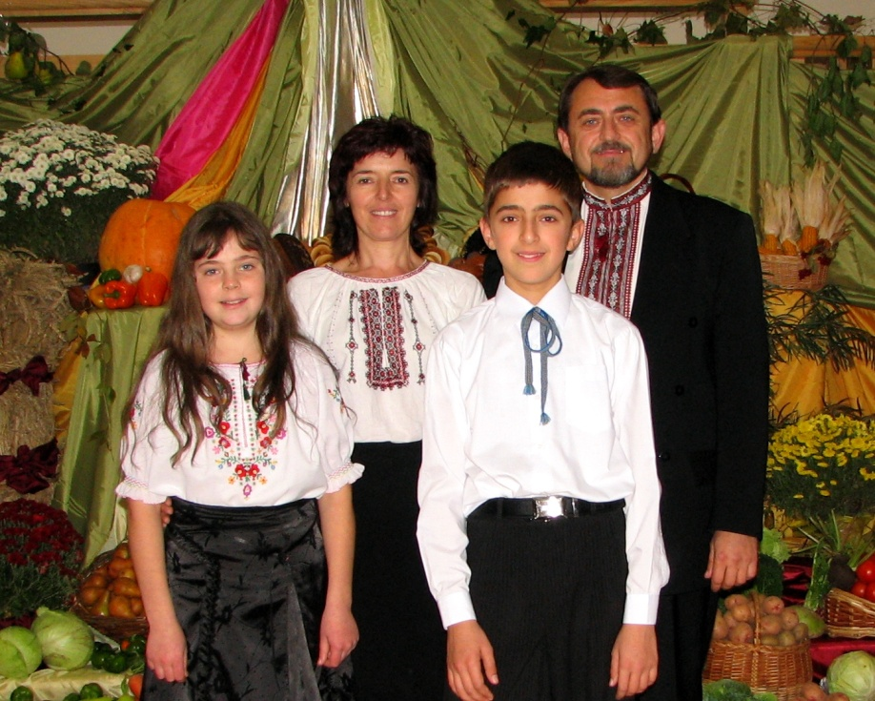
Sexuality as a gift from God
The whole person is called to holiness. That is why the Apostle Paul calls to glorify God in his body.

Slide 35
Sexuality as a gift from God
Human sexuality is two poles - male and female, which, although opposite, mutually need each other and complement each other, and not only in the bodily sphere.
Sex difference creates a fundamental interpersonal community, which the Bible calls "one body."

Slide 36
Sexuality as a gift from God
Sexuality, although most clearly manifested in the bodily dimension, is not limited to the anatomy and physiology of the sexual sphere.
The whole man - in all dimensions of his existence - is a man or a woman. These are two great ways to be human.

Slide 37
Spiritual dimension of sexuality
Human sexuality is rooted in the personal "I" of each person.
Sexuality is not only an attraction and not only emotions, it is a way of expressing a person. Sexuality deeply permeates the whole person, the whole person feels sexuality and is expressed through it.

Slide 38
Spiritual dimension of sexuality
The animal lacks a spiritual dimension that could be manifested in the sexual sphere, while in humans the actualization of sexuality cannot be subordinated to attraction and feelings, but must be a manifestation of devotion from one person to another.
Every actualization of bodily sexuality and feelings must be a manifestation of a conscious, personal act of love.

Slide 39
Spiritual dimension of sexuality
Physical unity must express the spiritual community.
Sexuality is not only a function of reproduction, it is a component of every human being.

Slide 40
Spiritual dimension of sexuality
Sexuality is the language of love in marriage.
Sexuality, which on the biological plane is the possibility of preserving the genus through the ability to reproduce, is at the same time a privileged place and form of interpersonal communication between spouses, the essence of which is love.

Slide 41
Spiritual dimension of sexuality
True love, love full of inner fullness, is when we choose a person for our own sake, when a man chooses a woman, and a woman chooses a man not only as “partner ”of sexual life, and as a person to whom he wants to give his life.

Slide 42
Spiritual dimension of sexuality
Sexuality finds its full realization in marriage, it is there that sexual intercourse confirms the complete devotion of spouses in love and takes place within a community that is naturally open to the birth of children.

Slide 43
Spiritual dimension of sexuality
Sexual intercourse outside marriage or satisfaction of sexual desire in any way outside intercourse is a manifestation of disorder in the sexual sphere, or, in other words, fornication and lust.

